Slide 2
Create a square inside the rectangle by drawing
only one line.
Continue this process without using the area of
the previous square until you can no longer fit
a square.

Slide 4

Let’s try more…

Slide 5
WHAT DO YOU THINK?
Did all of your rectangles split up the same
way?
Were you always able to fill the rectangle
completely?
If we told you the squares configuration could
you tell us what the rectangle will look like?
First let’s look at your rectangles on paper…

Slide 6
We can show this square configuration
in short notation
[2; 1, 1, 2]
[ 1; 1, 1, 3]
Now you try one…

Slide 7
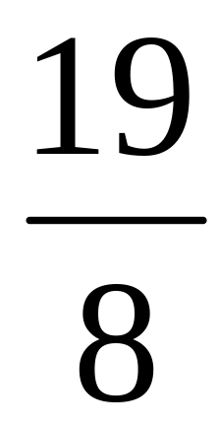

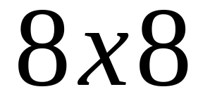

Evaluate: [ 2; 2, 1, 2 ]
8+8+3=19
8
3+3+2=8
2+1=3
1+1=2

Slide 8



What were the ratios of the
rectangles that you’ve tried so far?
What kind of numbers are these?
Whole numbers
Decimals
Rational numbers
Fractions
Integers
Irrational numbers

Slide 9
Let’s try another rectangle…

Slide 10
NOW…
WHAT DO YOU THINK?
Did this rectangle split up the same way?
Were you able to fill the rectangle
completely?
Why not?
Hmmmm…What was the ratio of the sides
for that rectangle?

Slide 11
Do you think it is possible to figure
out the decomposition of a rectangle
without drawing a picture?
Is it possible that the math is hidden
within the ratio itself?
Let’s find out…

Slide 12
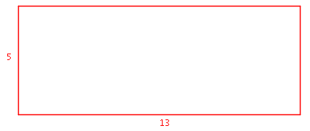
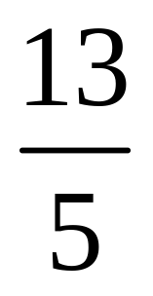
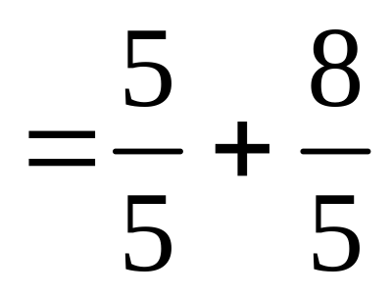
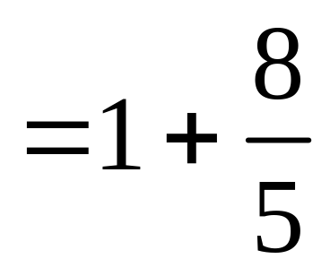

Slide 13
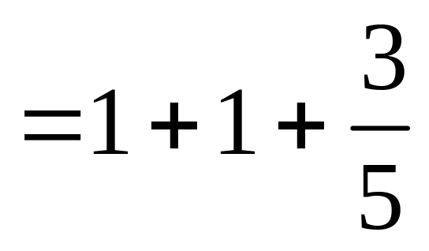
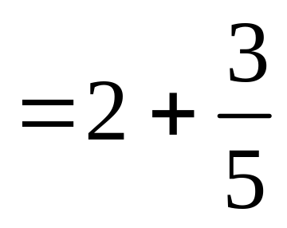

Slide 14
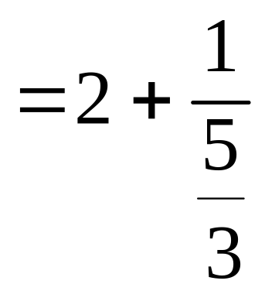
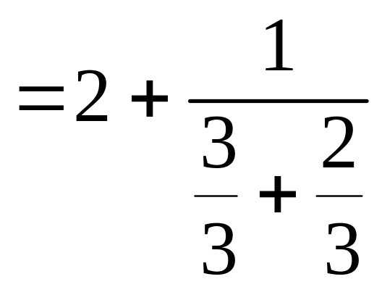
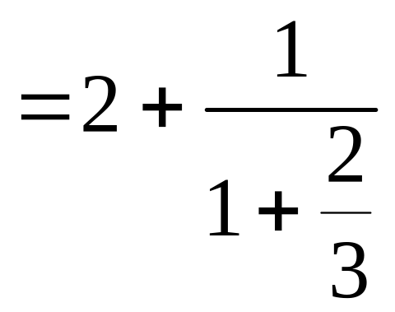

Slide 15
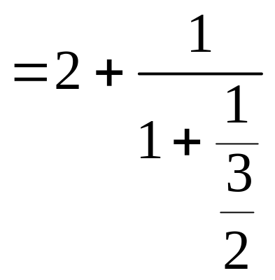
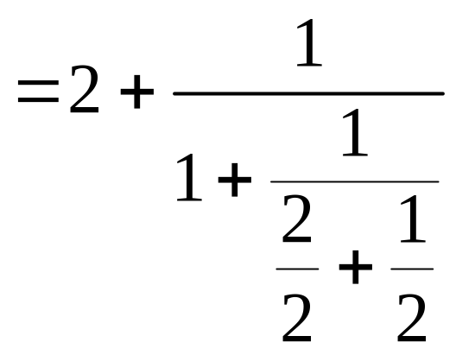
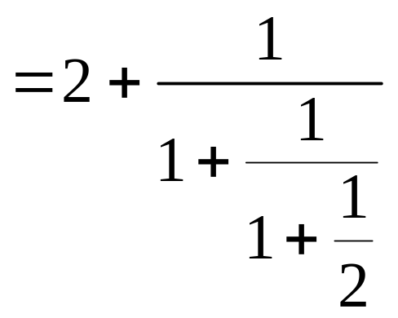

Slide 16
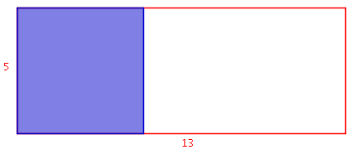
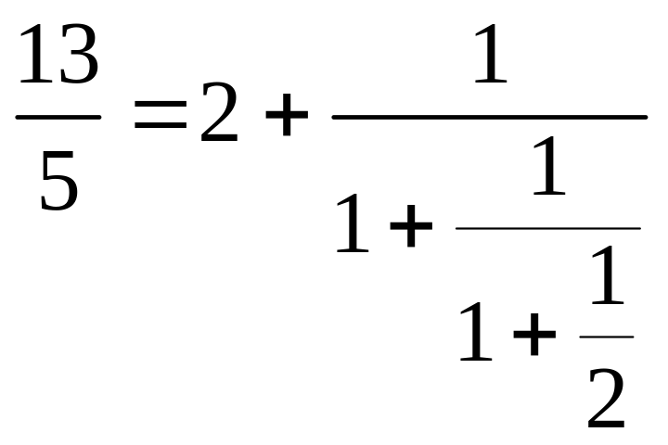
A Continued
Fraction

Slide 17
Continued Fractions
Notation
[2;1,1,2]

Slide 18
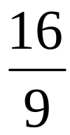
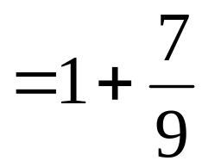
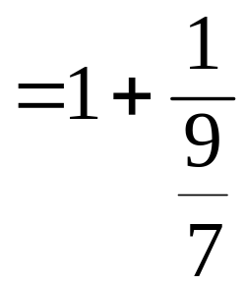
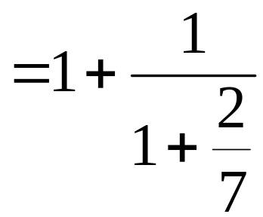
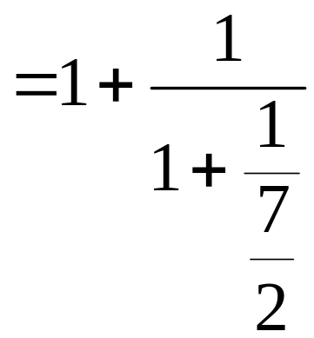
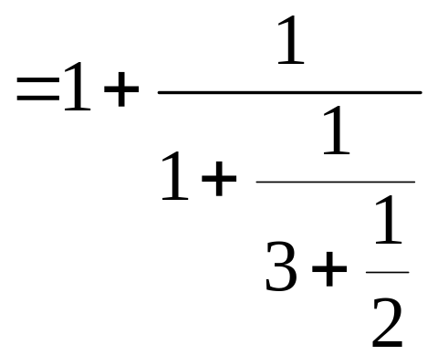
Try the math again…Write the Continued Fraction
= [1; 1, 3, 2]
_x001a__x0004_
_x001a__x0004_
_x001a__x0004_
_x001a__x0004_

Slide 19
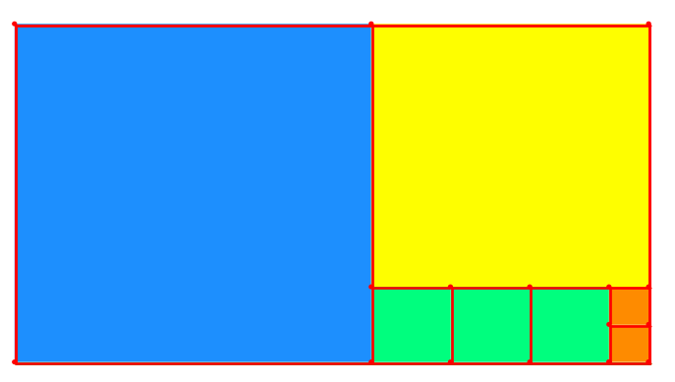
How can we check if this is correct?
Look at the decomposition of the rectangle
Algebraically, work from the bottom up
= [1; 1, 3, 2] =

Slide 20
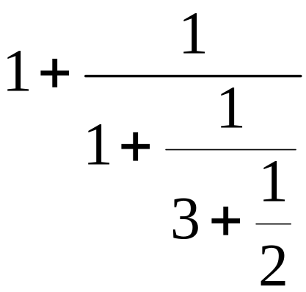
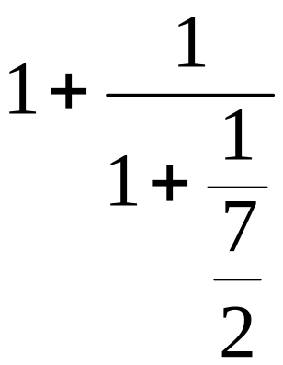
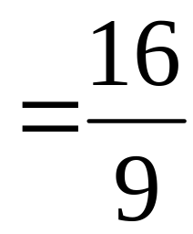
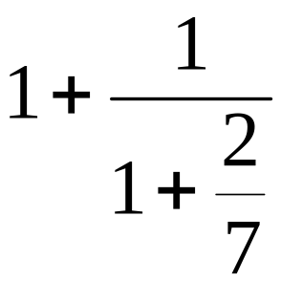
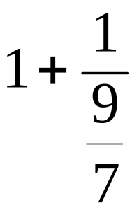
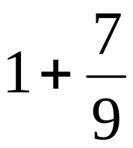
Algebraically…
Simplify
Add
Add
Simplify
Add

Slide 21
Why didn’t this one work?
The ratio of the sides is irrational
?

Slide 22
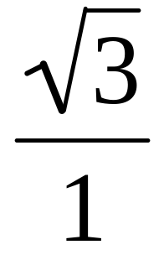
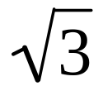
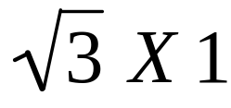
1
?
This rectangle had side lengths of :
Decimal Expansion begins: 1.73205080756887
Continued Fraction Notation for is: [1; 1, 2, 1, 2, 1, 2…]

Slide 23

A number is rational if and only if it can be expressed as a finite continued fraction

Slide 24
Continued Fractions
  Relates to the oldest algorithm known to Greek Mathematicians 300 BC
  Euclid’s Algorithm (gcf)
SUNSHINE STATE STANDARDS…
MA.A.1.3.1 MA.A.1.3.4
MA.A.3.3.1 MA.A.3.4.3
MA.C.2.3.1 MA.C.2.3.2

